Slide 1




Smart Power Management System
Review n° 2
Team 1 - Buck
12-11-2020
INSA Toulouse
Xavier Bourlot
Thibault Jean
Clarisse Calmo
Xiaohu Zhang

Slide 2


TEAM PRESENTATION
TEAM SKILLS :
Team members | Roles
BOURLOT Xavier | Inspector of finished products
CALMO Clarisse | Electronics Engineer / Super Manager
JEAN Thibault | Software and Hardware Engineer
ZHANG Xiaohu | Analog Electronic Engineer
Electronic system conception
Software programming
Prototyping
Routing
Project management
Cooking

Slide 3

SYSTEM OVERVIEW
Smart Power Management System : intelligent system capable of providing energy, either from power network or from solar panel.
Solar Panel Supply Unit : autonomous power block
Communicating Plugs : charges connecting points
.
...
...
Buck part : Energy converter
Our mission : implementing this sub-system.

Slide 4

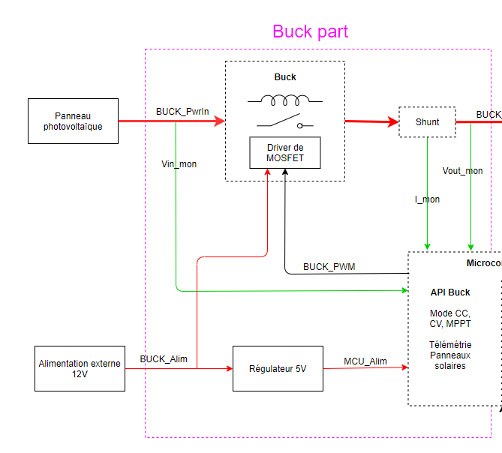
HARDWARE ARCHITECTURE
-Power block located right after the solar panel.
-Energy delivery : up to 200W
-Various control modes :
constant voltage,
constant current,
MPPT,
open loop (test mode)
Towards BMS
Microcontroller

Slide 5

SOFTWARE ARCHITECTURE
Software high level architecture
Function Management_Mode : Management of the different operating modes
Function Get_BuckOutputCurrent
Function Get_BuckOutputVoltage
Function Get_BuckOutputPower
Function Get_BuckInputVoltage
These different functions are there to retrieve the quantities useful for the regulation modes.
Main specifications we are going to implement :
The power supply will be taken first from the photovoltaic panel
Management of the different regulation modes
Prevention against the risks of too much power and too much discharge of the batteries

Slide 6

Next steps
The future step of the project are :
Software development on the project library as well as on the test functions
Finish composant sizing & selection
Continue the schematic developpement and start the PCB layout under Altium
Making further simulations under LTSpice
Writing a report for the final low level architecture

Slide 7

Forecast schedule
This week : finalize the low level architecture
In 2 weeks : send the final schematic & BOM
Next month : write a report with the final software architecture
In 2 months : boards fabrication & write a report with the unit tests

Slide 8

PREVIOUS REVIEW CONTENT
Last month, we introduced a summary of the work initiated :
An overview of the smart power management system
The team skills
The hardware & software high level architecture
Our planning

Slide 9
HARDWARE ADVANCEMENT
Tasks performed since our last meeting :
Finalize the low level architecture
Component selection & sizing
Schematic development
LTSpice simulations
Edit project library in Altium
Edit the BOM
Finalize the PCB routing

Slide 10

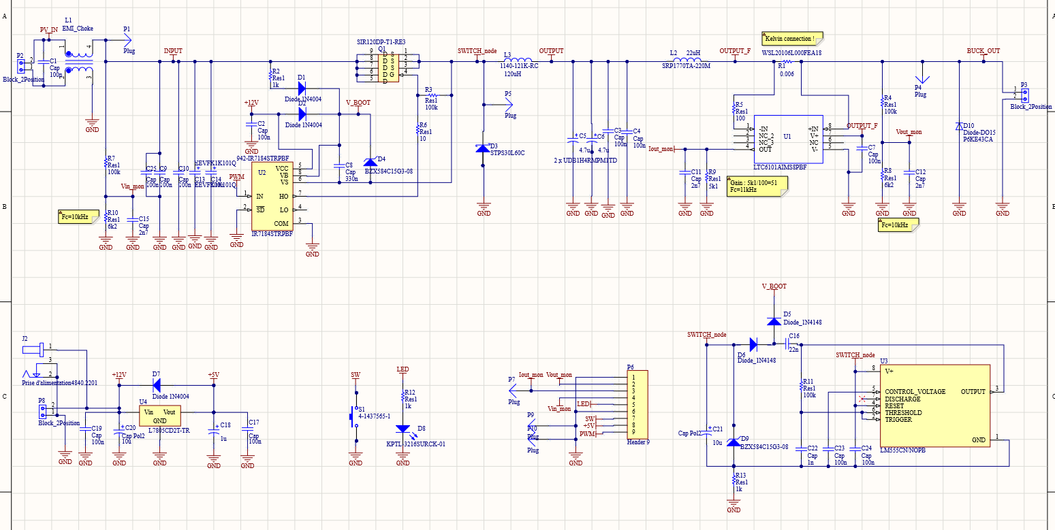
FINAL HARDWARE SCHEMATIC

Slide 11

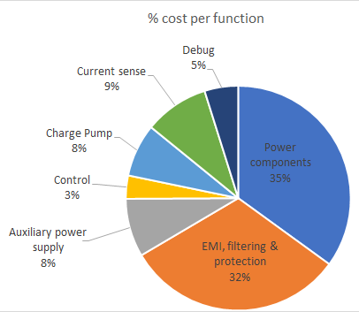
ESTIMATED COSTS
- Major costs come from power components
→ power conversion
- EMI (filtering) generates important costs too
→ common mode choke
Costs reduction envisaged :
- Eliminate the external charge pump by restricting the duty cycle in software.
Unsupported costs :
The Nucleo card is shared between the BMS & Buck team.

Slide 12
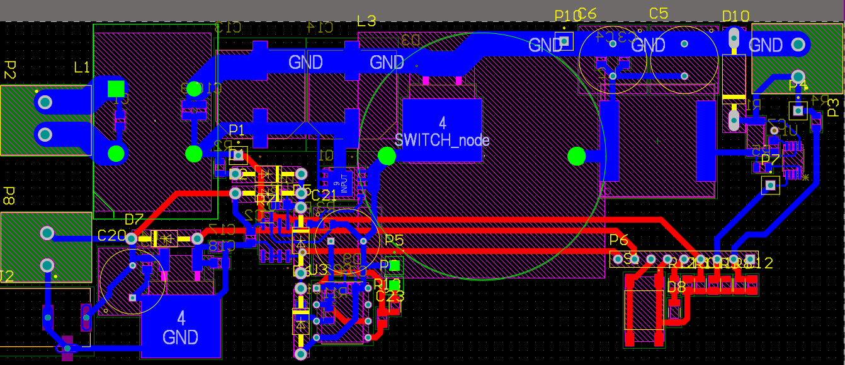
PCB ROUTING -2D

Slide 13
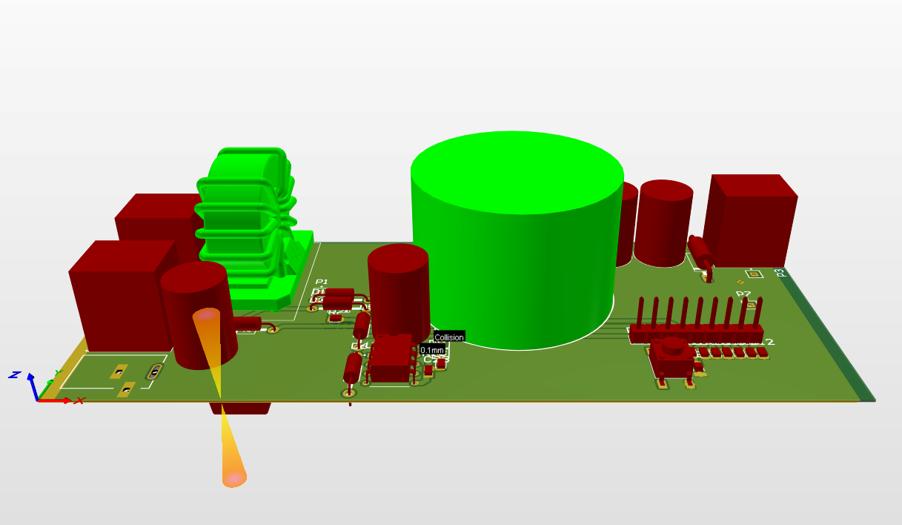
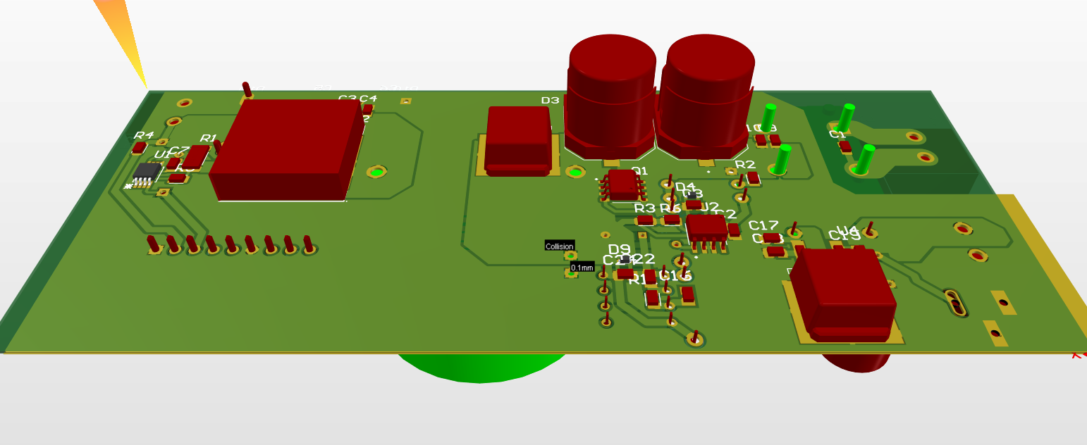
PCB ROUTING -3D
View of the last version of our PCB design

Slide 14
SOFTWARE ADVANCEMENT
Tasks performed since our last meeting :
Finalize the low level architecture
Software architecture class diagram
Identify functions, constants and variables.
Start the development with STM32CubeIDE
Initialize our peripherals
Write the functions content
Make tests with a Nucleo card
Test the PWM and ADC with DMA

Slide 15

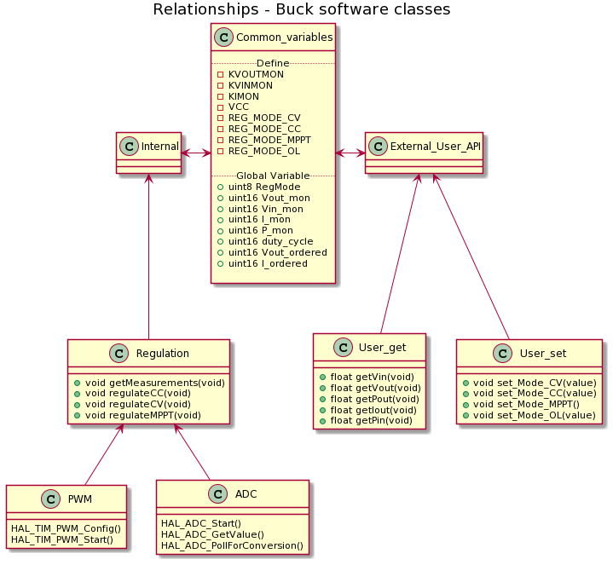
SOFTWARE ARCHITECTURE DIAGRAM
We are developing the software with a :
3-layers architecture
- High level layer dedicated to management
- Middle level layer dedicated to regulation to meet the buck specifications
- Low level layer as a link with the hardware
2-parts structure - Internal part for processing
-External user API

Slide 16
TIME MANAGEMENT
Now, we are around 60% of the allotted time and we met the goals of our initial planning.
Team feelings :
comfortable with the subject
confident for the final steps
Work pace :
a considerable increment is done each week
documentation & report are regularly updated in parallel of development

Slide 17
Next steps
The future steps of the project are :
Complete the software structure
Finish the final software architecture report
Pursue and document software unitary tests
Make further hardware tests in lab rooms
Send the PCB files for production & validate design

Slide 18



Thank you for your attention
Do you have any question

